Slide 1
JAVA CODE – MOVIE TICKET BOOKING
Harish m
Rishabh kumar patel
Preetesh r shetty

Slide 2
Introduction
Java is a high-level, class-based, object-oriented programming language that is designed to have as few implementation dependencies as possible. It is a general purpose programming language intended to let programmers write once, run anywhere
Java was originally developed by James Gosling at Sun Microsystems and released in May 1995 as a core component of Sun Microsystems’ Java platform.
As of October 2021, Java 17 is the latest version.

Slide 3
Objective
A program which facilitates the Basics of Ticketing System through a End-User Consoles.
Hassle free and booking of tickets at the comfort of your home
Using this software as a model software, the same code along w graphics can be used to develop apps and websites to book movie tickets online.
This model is only suitable for project purposes.

Slide 4
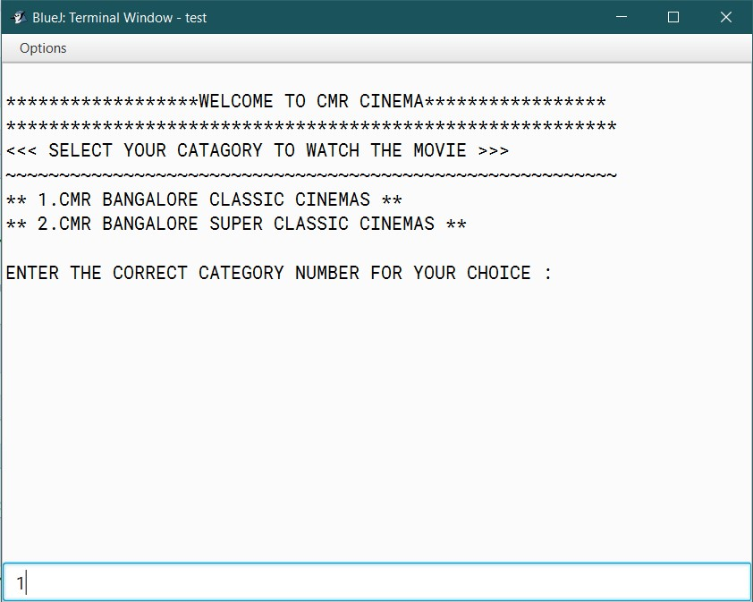
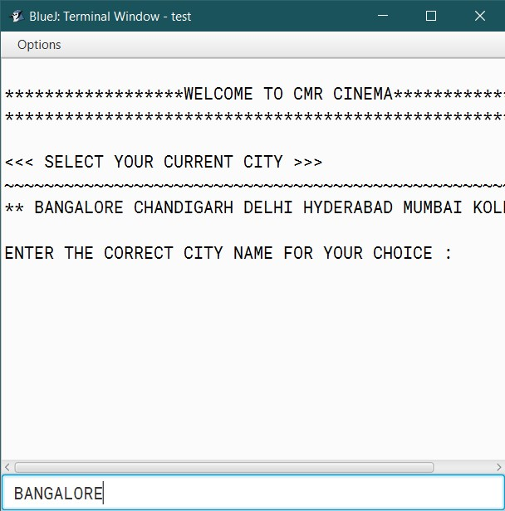
Output
1 2

Slide 5
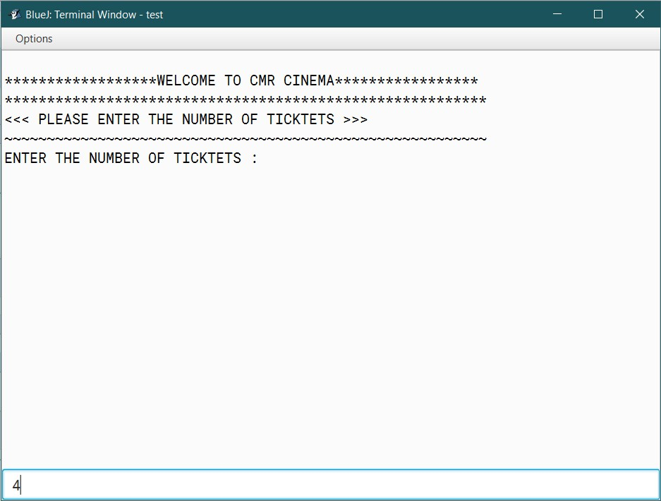
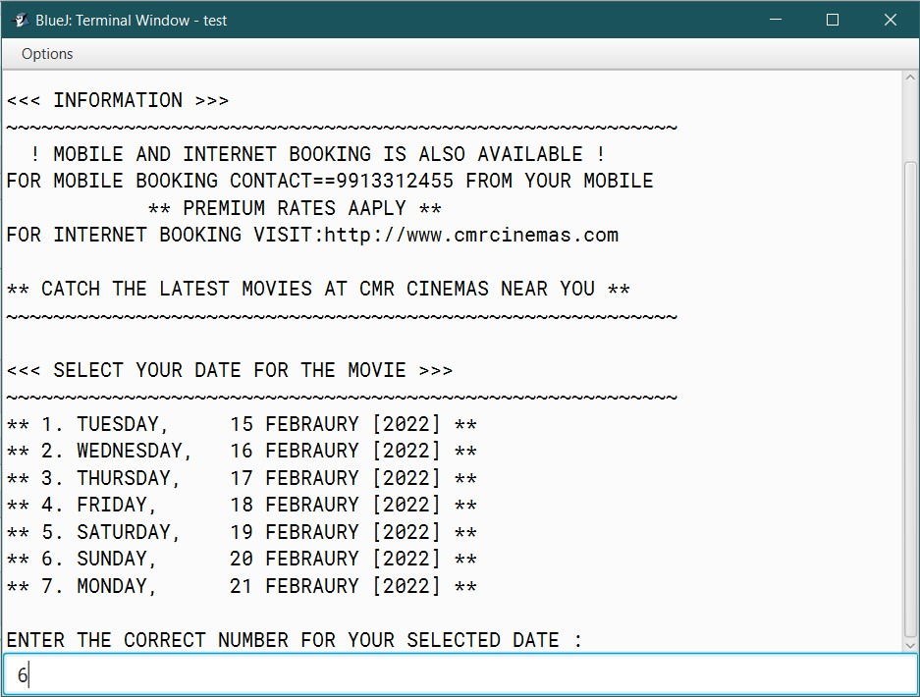
3 4

Slide 6
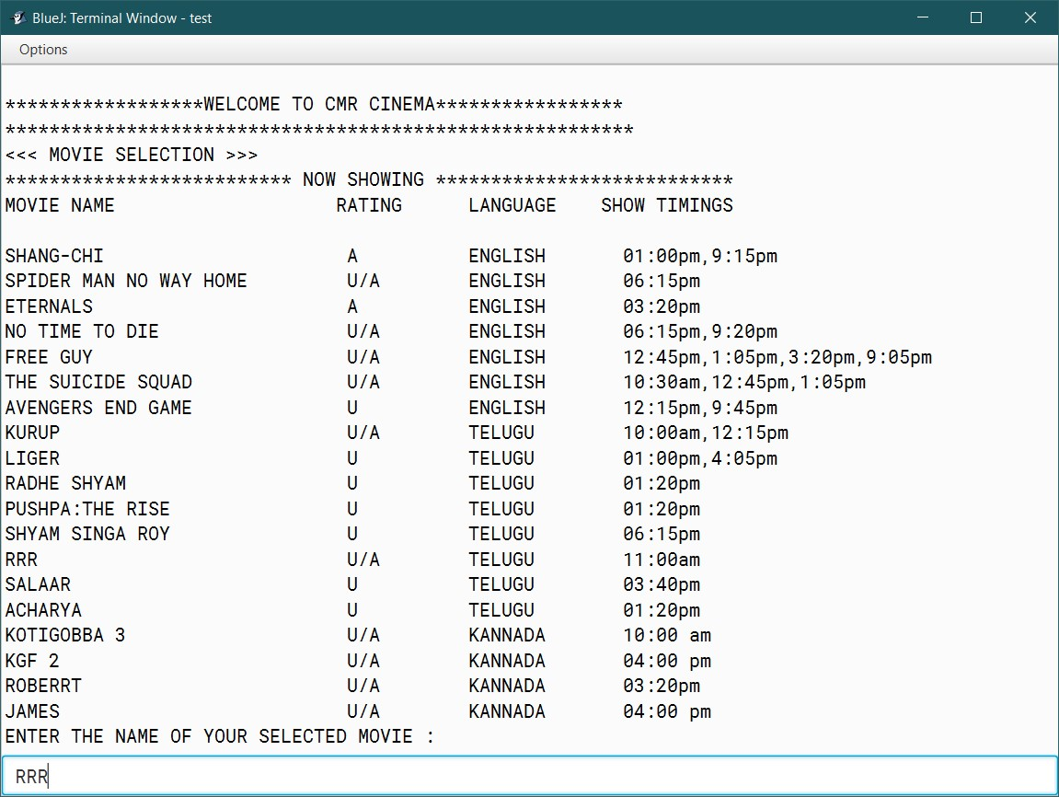
5

Slide 7
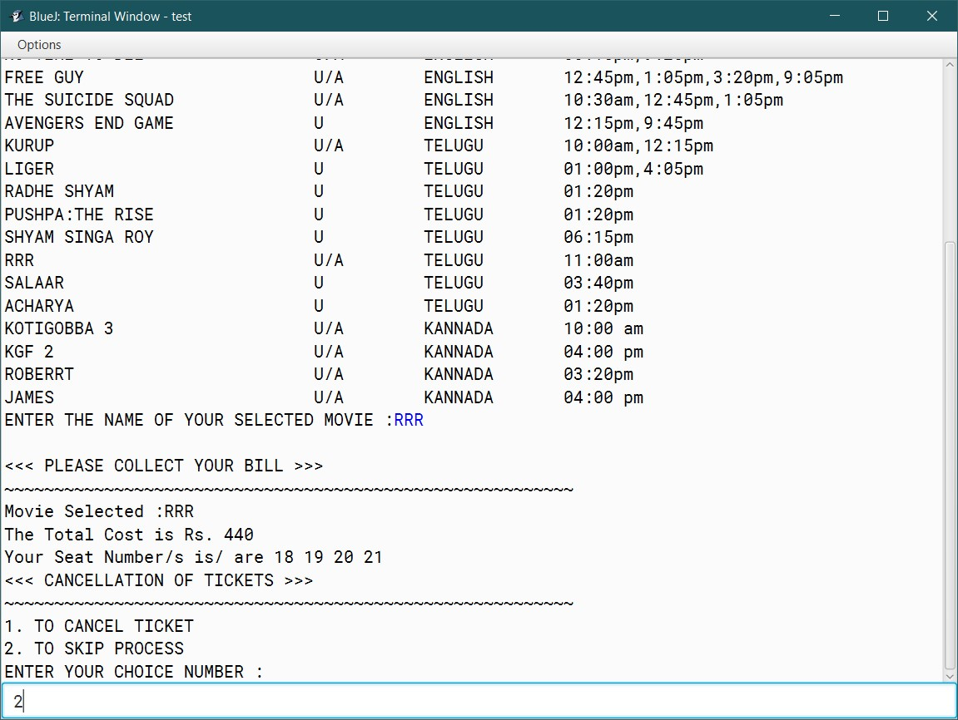
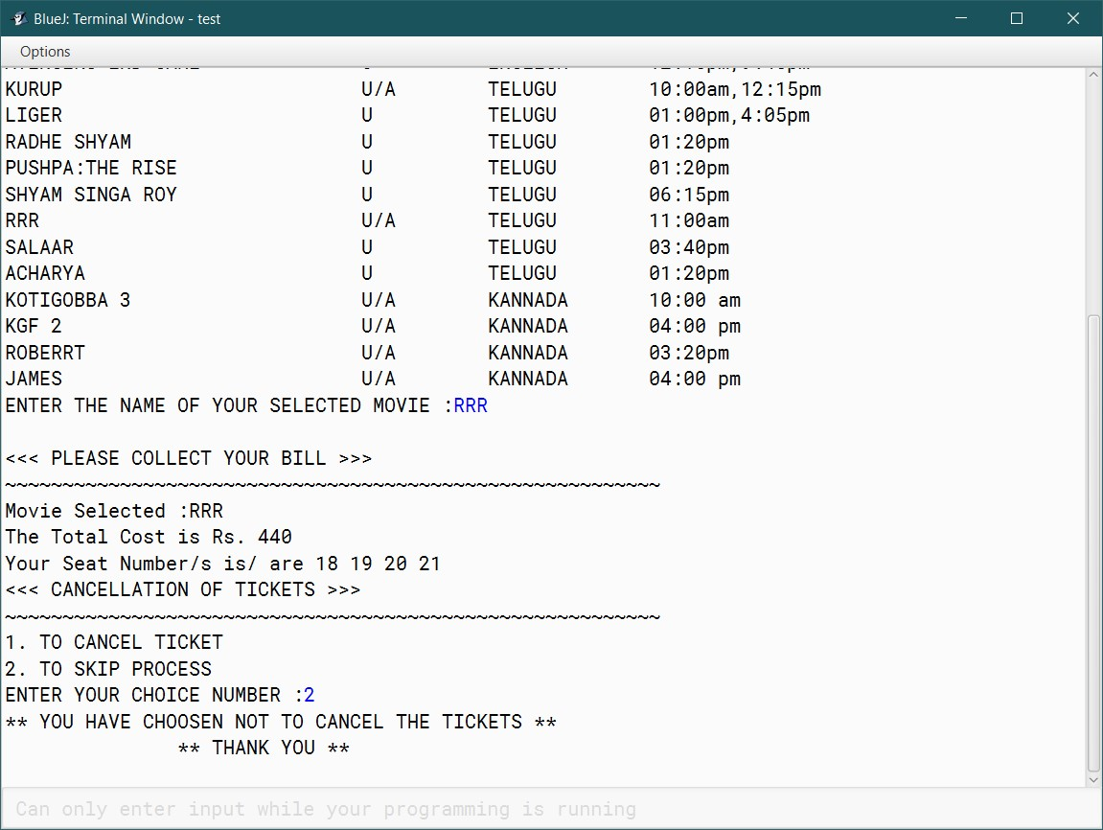
6 7

Slide 8
THANK YOU

